Slide 1
Crash Analysis with Reverse Taint
Powered by Taintgrind
Marek Zmysłowski
V. 23102019

Slide 2

whoami
Security Researcher @
Interested in fuzzing and vulnerability finding
Fan of The Matrix and Hacker movies

Slide 3
Crash Analysis with Reverse Taint

Slide 4
Crash Analysis with Reverse Taint
What is a crash?
Crash, or system crash, occurs when a computer program (...) stops functioning properly and exits. *
An application typically crashes when it performs an operation that is not allowed by the operating system. The operating system then triggers an exception or signal in the application. Unix applications traditionally responded to the signal by dumping core. *
Why is it important to identify a crash?
“performs an operation that is not allowed”. This indicate that inside the application a bug exists. When the crash is identified and recurrent the bug can be found.
*https://en.wikipedia.org/wiki/Crash_(computing)

Slide 5
Crash Analysis with Reverse Taint
How to identify a crash?
“operating system then triggers an exception or signal” Different operating systems contain different mechanisms to “collect” crashes. Some perform core dump, store the memory (Linux), other attach the debugger to allow user the debugging session with the crashed application (Windows).
How do we get crashes?
“That, Detective, is the ‘right question.’”
“I, Robot” (2004)

Slide 6
Hunting in the wild
How can a crash be found?
There are many different techniques and strategies. Code review, static analysis, manual analysis and one of the most popular techniques that we will be also mentioned here, fuzzing. The sooner the bug is found in the production process, the less the costs are.
So what is ‘fuzzing’?
The idea behind fuzzing is very simple. Let’s take an malformed input and feed it to the application. Maybe it will crash. Of course, how the input is “chosen” and how the crashes are caught is a topic for another presentation(s).

Slide 7
Fuzzers
American Fuzzy Lop
The godfather of all is, of course, AFL. However, recent years brought multiple fuzzers used for different purposes. Some of them are different clones of AFL, some of them try to do things differently.
Everyone can find something for themselves.
QSYM
AFL++
HonggFuzz
WinAFL
Angora

Slide 8
Real Example - Fuzzing
OpenCTM is primarily a file format for storing 3D triangle meshes in a compact yet versatile format. In order to make it easy for software developers and 3D designers to support the format, an easy to use software library is provided that can read and write OpenCTM format files.
http://openctm.sourceforge.net

Slide 9
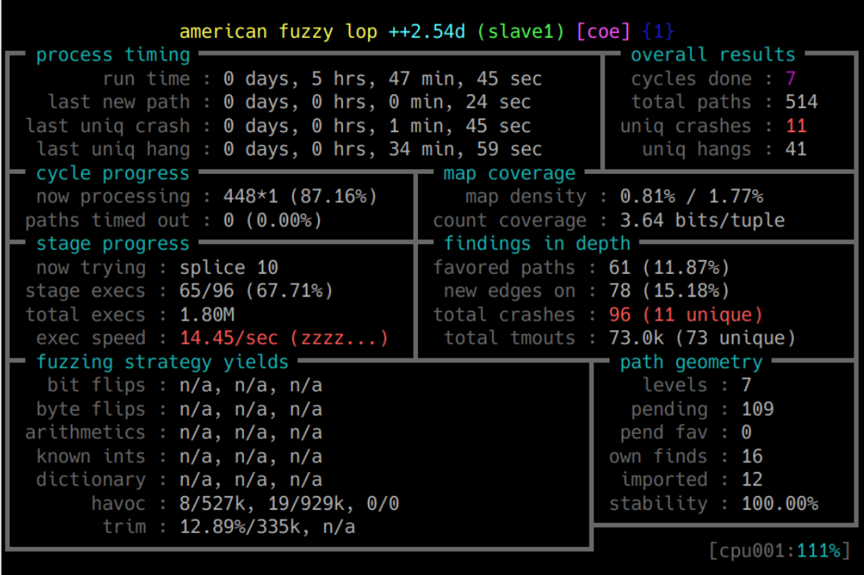
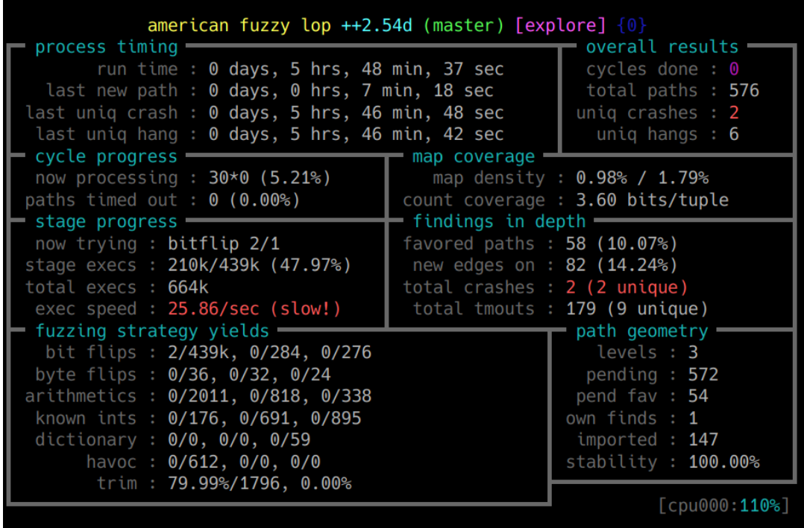
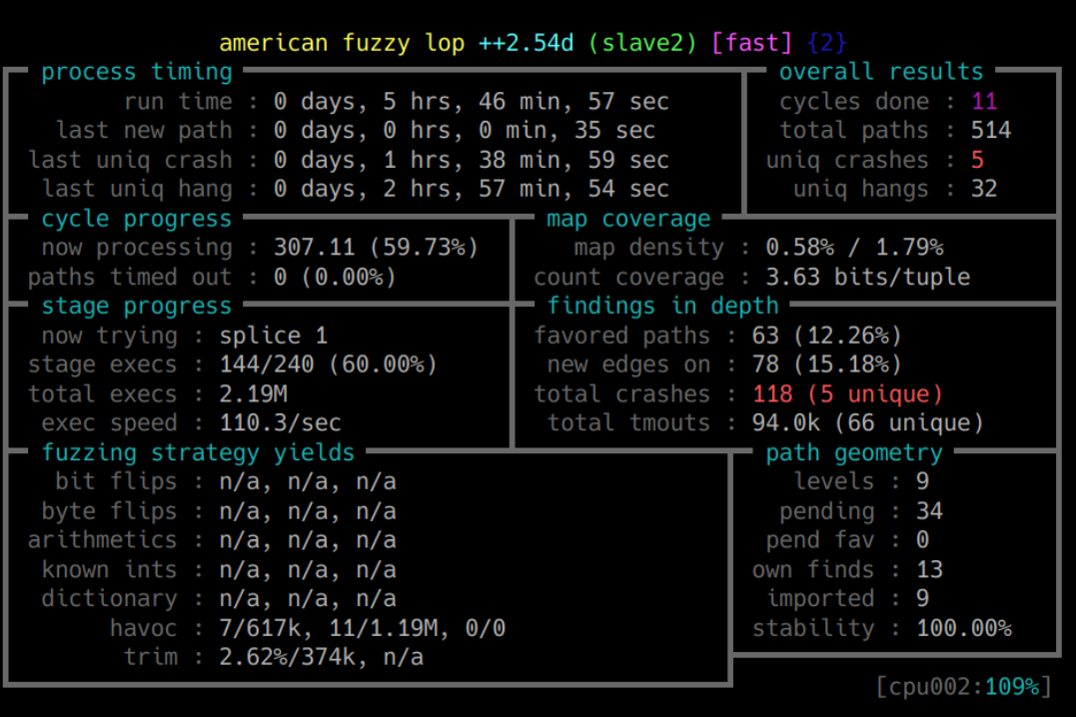
Real Example - Fuzzing

Slide 10
Crash vs Bug
What is the difference between Crash and Bug?
Crash is a result of incorrectly working code caused by a bug. Sometimes it happens, that the crashing place and the bug place are “the same”. And sometimes not ...
Is one crash caused by one bug?
No.

Slide 11


Crash vs Bug
Case 1.
One bug causes one crash.
This is the easiest situation as the identification is straightforward.

Slide 12
Crash vs Bug
Case 2.
One bug can cause a few crashes.
This happens quite often especially with simple buffer overflows where the “size” variable is used. Direct read or write and access different memory regions cause different crashes.

Slide 13
Crash vs Bug
Case 3.
A few bugs can cause one crash.
This depends on how we identify crash. The simplest example can be a frame processor. For the different types of frame, the size parser works incorrectly and may cause different crashes for different paths.

Slide 14
Crash vs Bug
In an additional experiment we computed a portion of groundtruth. We applied all patches to cxxfilt from the version we fuzzed up until the present. We grouped together all inputs that a particular patch caused to now gracefully exit [11], confirming that the patch represented a single conceptual bugfix. We found that all 57,142 crashing inputs deemed “unique” by coverage profiles were addressed by 9 distinct patches.
Stack hashes did better, but still over-counted bugs. Instead of the bug mapping to, say 500 AFL coverage-unique crashes in a given trial, it would map to about 46 stack hashes, on average. Stackhashes were also subject to false negatives: roughly 16% of hashes for crashes from one bug were shared by crashes from another bug. In five cases, a distinct bug was found by only one crash, and that crash had a non-unique hash, meaning that evidence of a distinct bug would have been dropped by “de-duplication.”
“Evaluating Fuzz Testing” https://arxiv.org/pdf/1808.09700.pdf

Slide 15
Crash vs Bug
So what is needed?

Slide 16
Crash Analysis with Reverse Taint

Slide 17
Crash Analysis with Reverse Taint
What is crash analysis and why do we need that?
Crash analysis is a process of evaluating exploitability of the crash and identifying the root cause of this crash. If you are fuzzing something, the number of crashes can be huge. Also the impact and consequences (criticality) the bug might have, depends on the application technology and the system.
So what exactly do we analyze?
There are two major things to analyze: the crash and the bug.

Slide 18
Analysis - Crash
What type of the crash is it?
For example: Out-of-bound read, NULL Pointer Dereference, Buffer Overflow, etc.
Is the crash exploitable?
It is a part of identification process to find out if the crash can be used to achieve something more than just crash the application - read a piece data, overwrite memory or execute code.
Critical or exploitable - what is the difference?
The exploitability related only to bug and crash itself. The criticality is related to the whole environment. A Safe NULL Pointer Dereference is different for a nuclear power plant software and a kids game.

Slide 19
Analysis - Bug
The second important analysis part is to identify the bug. As this was mentioned before, there can be different relations between bug and crash.
It is also important to how inputs (which bits and bytes) correlate with the bug. This of course may influence the crash later and its exploitability.
What different relation are here?
User data can control the crash directly (e: offset inside the table is calculated based on user data) or indirectly (e: the incorrect branch is taken)
For example: NULL Pointer Dereference vs Safe NULL Pointer Dereference

Slide 20
Analysis - Bug (Direct vs. Indirect)
void *pointer = NULL
char table[100]
int index = 0
char user_data
user_data>100
table[user_data] = 0
pointer[index] = 0

Slide 21
Analysis - Few Interesting Tools
crashwalk
cwtriage
cwdump
cwfind
It runs crash files with instrumentation and outputs results in various formats.
It summarizes crashes in a crashwalk database by major / minor stack hash. Although AFL (for example) already de-dupes crashes, bucketing summarizes those crashes by an order of magnitude or more. Crashes that bucket the same have exactly the same stack contents, so they're likely (not guaranteed) to be the same bug.
It is a simple utility to output the filenames of all crashes matching a given hash. I use it in combination with xargs to bulk delete / move crash files.
https://github.com/bnagy/crashwalk

Slide 22
Analysis - Few Interesting Tools
afl-utils
afl-collect
afl-minimize
Copies all crash sample files from an afl synchronisation directory (used by multiple afl instances when run in parallel) into a single location providing easy access for further crash analysis. Also executes exploitable on them and remove uninteresting crashes.
Helps to create a minimized corpus from samples of a parallel fuzzing job.
https://github.com/rc0r/afl-utils

Slide 23
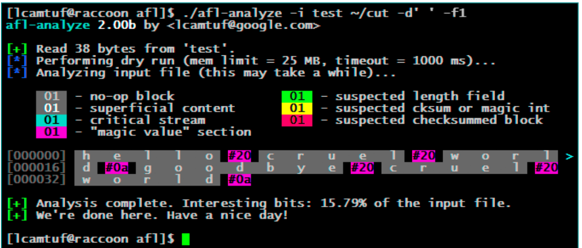
Analysis - Few Interesting Tools
afl-analyze
It takes an input file, attempts to sequentially flip bytes, and observes the behavior of the tested program. It then color-codes the input based on which sections appear to be critical, and which are not.
While not bulletproof, it can often offer quick insights into complex file formats.
https://lcamtuf.blogspot.com/2016/02/say-hello-to-afl-analyze.html

Slide 24
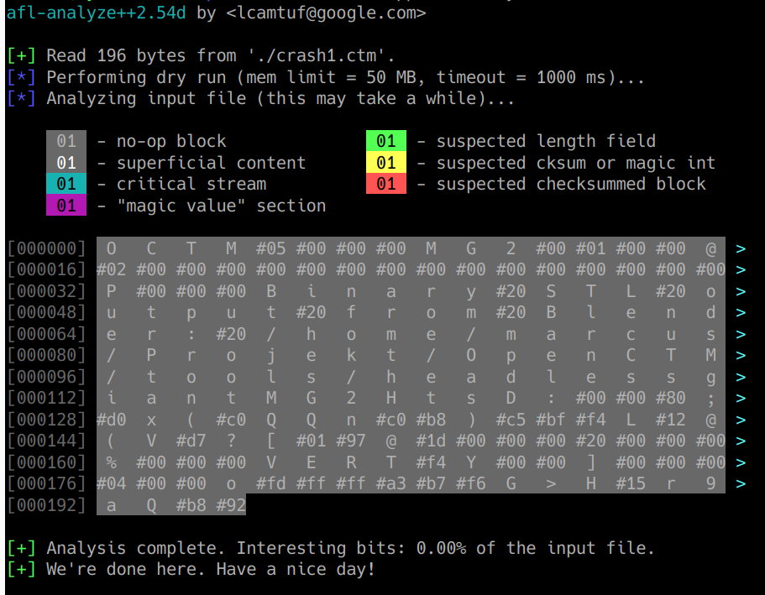
afl-analyze - Doesn’t always work :( *
*Of course it works, it just does not always give expected results.

Slide 25
Crash Analysis with Reverse Taint

Slide 26
Tainting
What is tainting?
The purpose of dynamic taint analysis is to track information flow between sources and sinks. Any program value whose computation depends on data derived from a taint source is considered tainted. Any other value is considered untainted.
What are the types of tainting?
The direct value is tainted
Indirect/Control flow
Address/Pointer relation
https://users.ece.cmu.edu/~aavgerin/papers/Oakland10.pdf

Slide 27
Tainting - Types
Direct Value
Y = X + 2
Indirect/ Control Flow
if (X > 2)
Y = 5
else
Y = 10
Address/Pointer
Y = A[X]

Slide 28
Tainting Propagation (Policy)
Depends on the application, different rules can be used to propagate the taint. It is a set of rules how the source operants are propagated to destination. In standard taint analysis, the destination operand is typically marked as tainted if any of the source operands is tainted regardless of how the specific semantics of s affects its destination operands.

Slide 29
Tainting - Issues
What is over-tainting?
Overtainting occurs when code or data identified by the analysis as tainted is not in fact influenced by any taint source (false-positive).
What is under-tainting?
Under-tainting occurs when code or data that is influenced by a taint source is not identified by the analysis as tainted. Such imprecision can be problematic, especially in systems where the result of the taint analysis is critically important (false-negative).

Slide 30
Powered by Taintgrind

Slide 31
What is Valgrind?

Slide 32
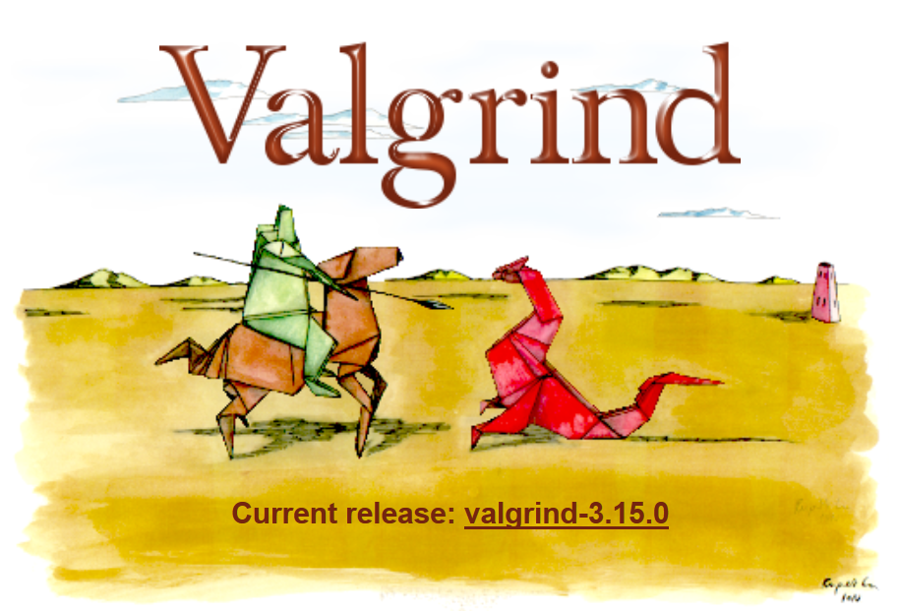
Valgrind
It is an instrumentation framework for building dynamic analysis tools. It comes with a set of tools each of which performs some kind of debugging, profiling, or similar task that helps you improve your programs. Valgrind's architecture is modular, so new tools can be created easily and without disturbing the existing structure.
http://valgrind.org

Slide 33
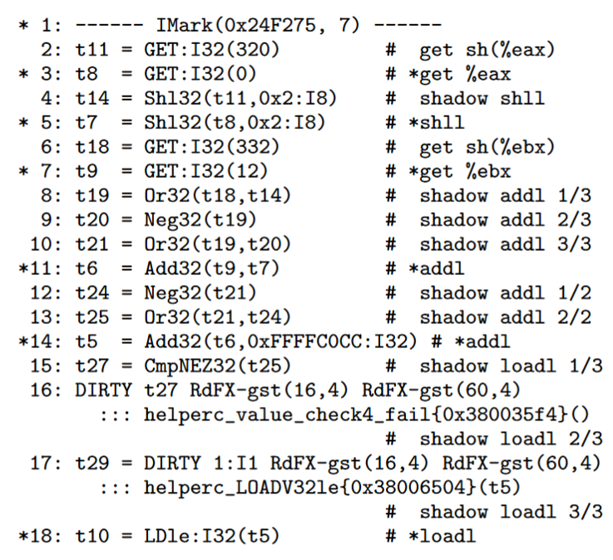
Valgrind IR
Valgrind had an x86-specific,part D&R, part C&A, assembly-code-like IR in which the units of translation were basic blocks. Since then Valgrind has had anarchitecture-neutral, D&R, single-static-assignment (SSA) IR that is more similar to what might be used in a compiler. IR blocks are superblocks: single-entry, multiple-exit stretches of code.
*http://valgrind.org/docs/valgrind2007.pdf

Slide 34
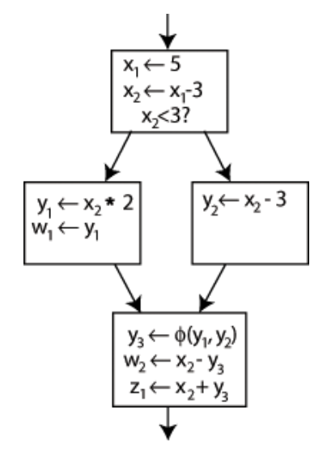
Single-Static-Assignment (SSA)
It is a property of an intermediate representation (IR), which requires that each variable is assigned exactly once, and every variable is defined before it is used. Existing variables in the original IR are split into versions, new variables typically indicated by the original name with a subscript in textbooks, so that every definition gets its own version. In SSA form, use-def chains are explicit and each contains a single element.
*https://en.wikipedia.org/wiki/Static_single_assignment_form

Slide 35
What is Taintgrind?

Slide 36
Taintgrind
Taintgrind is based on Valgrind's MemCheck and Flayer plugin.
Taintgrind borrows the bit-precise shadow memory from MemCheck and only propagates explicit data flow. This means that Taintgrind will not propagate taint in control structures such as if-else, for-loops and while-loops. Taintgrind will also not propagate taint in dereferenced tainted pointers.
http://valgrind.org/docs/memcheck2005.pdf

Slide 37
Taintgrind - Propagation Rules
The direct value is tainted
Indirect/Control flow
Address/Pointer relation

Slide 38
Taintgrind - Propagation Rules
What are the Taintgrind propagation rules?
The granularity for the memory operation is 1 byte.
For the registry operation it is the size related to the operand. Even if one byte is used there, the whole register will still be tainted. In such case, the Taintgrind is overtainting.
However, because the Taintgrind is handling first type, it is also under-tainting.

Slide 39
Taintgrind - Propagation Rules
Overtainting bit-byte operation
WRITE
READ

Slide 40
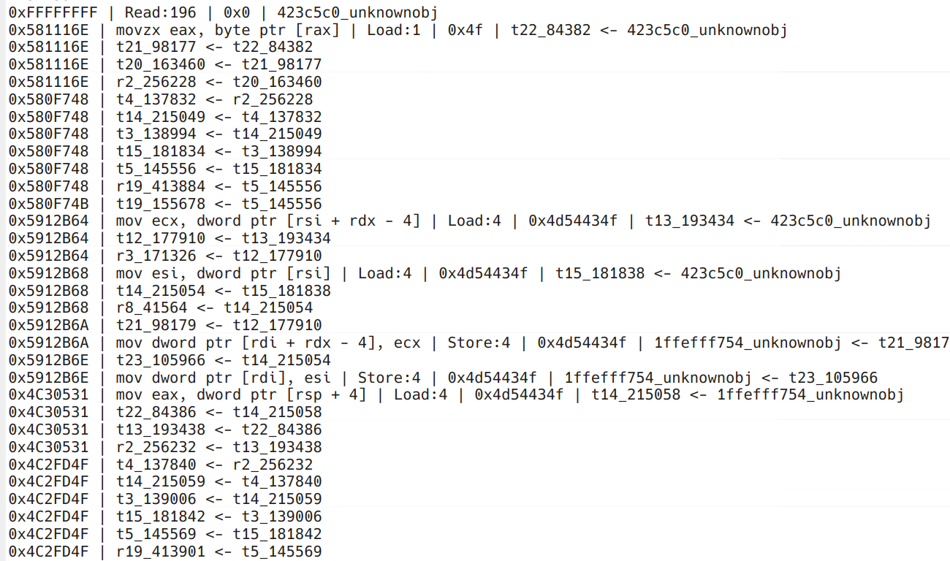
Taintgrind
Here is the example of logs and how the taint is propagated over the file.
The job is to find all the patch from the end of the file to the beginning.
One instruction can be tainted with multiple input.

Slide 41
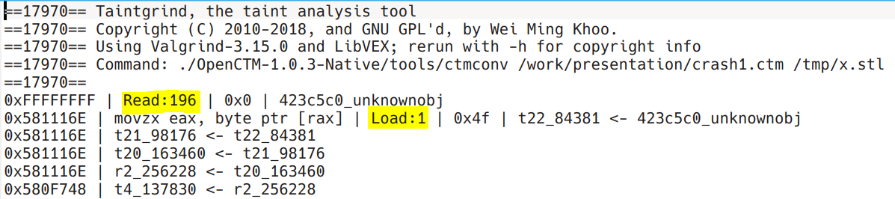
Taintgrind
The original Taintgrind was not useful for the purpose of the reverse taint. It was missing a few parts.
What was changed?
The “Read” function was not showing the size of data that was read.
The “Load” and “Store” functions were also not presenting the size of the operation.

Slide 42
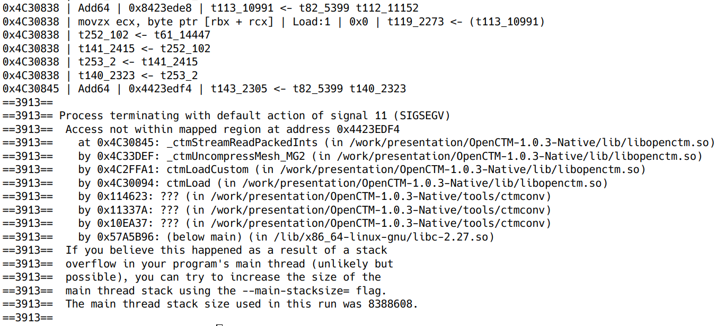
Taintgrind
Tracked variables
Reported crash

Slide 43
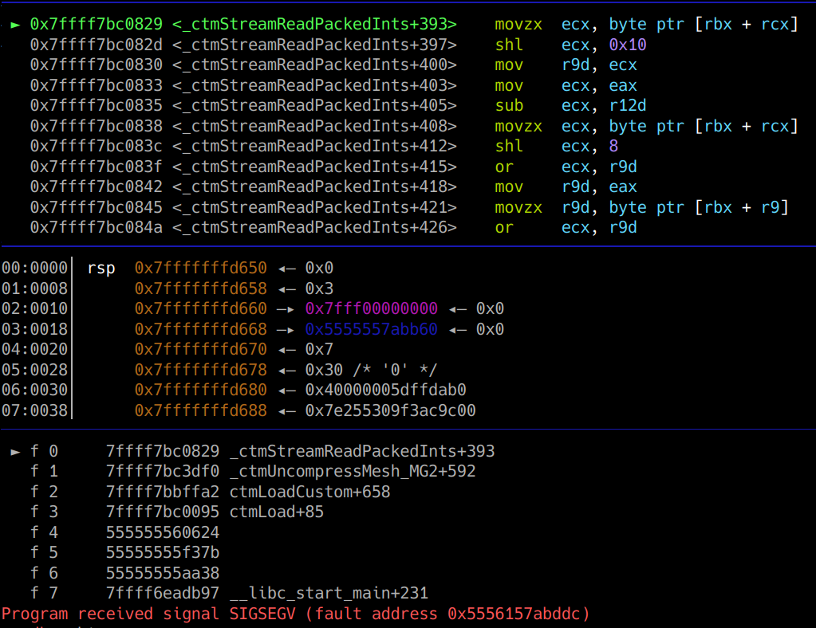
GDB
Instruction that caused the crash
Function where the crash occurred

Slide 44
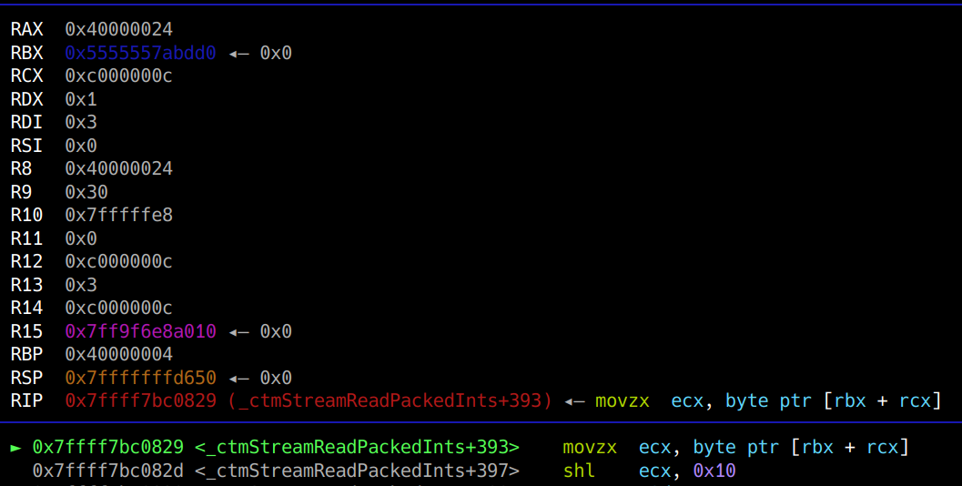
GDB
The crash occurred with the reference to the address that is a sum of RBX and RCX

Slide 45
Taintgrind
./valgrind/build/bin/valgrind
--tool=taintgrind --file-filter=/work/presentation/crash1.ctm --compact=yes
--taint-start=0
--taint-len=196
-- ./OpenCTM-1.0.3-Native/tools/ctmconv /work/presentation/crash1.ctm /tmp/x.stl

Slide 46
Taintgrind
./valgrind/build/bin/valgrind --tool=taintgrind
--file-filter=/work/presentation/crash1.ctm
--compact=yes
--taint-start=0
--taint-len=196
-- ./OpenCTM-1.0.3-N…..
Calling the Taintgrind tool.
This is the name of the file that needs to be tainted. It must be FULL path.
Makes the log file smaller.
Offset inside the file.
Taint size
Command

Slide 47
Crash Analysis with Reverse Taint

Slide 48
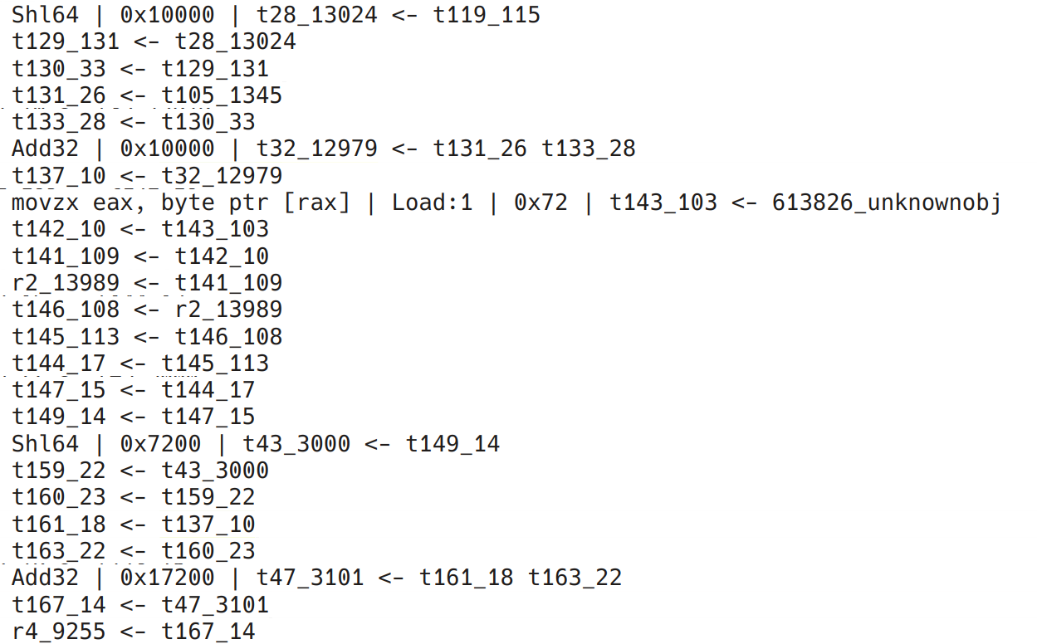
Reverse Tainting the Value
An example how the values are tracked.

Slide 49
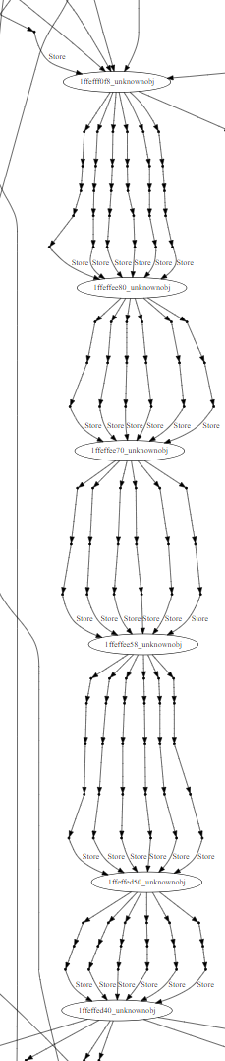
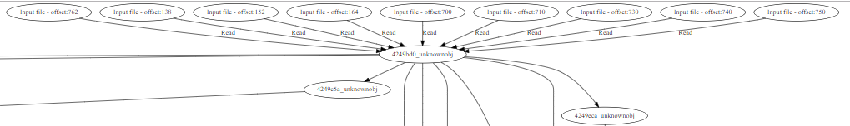
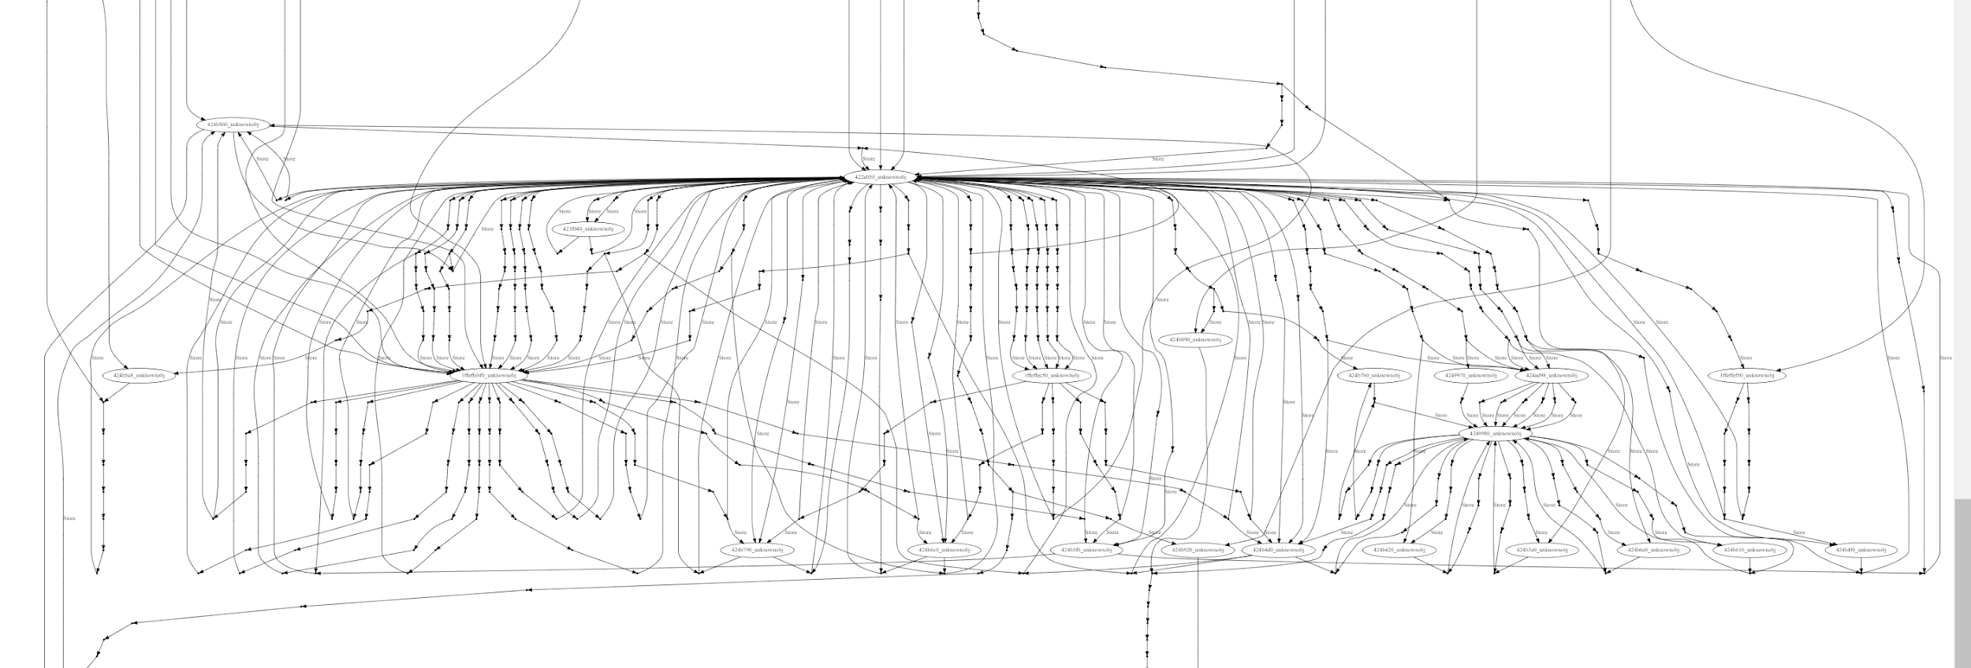
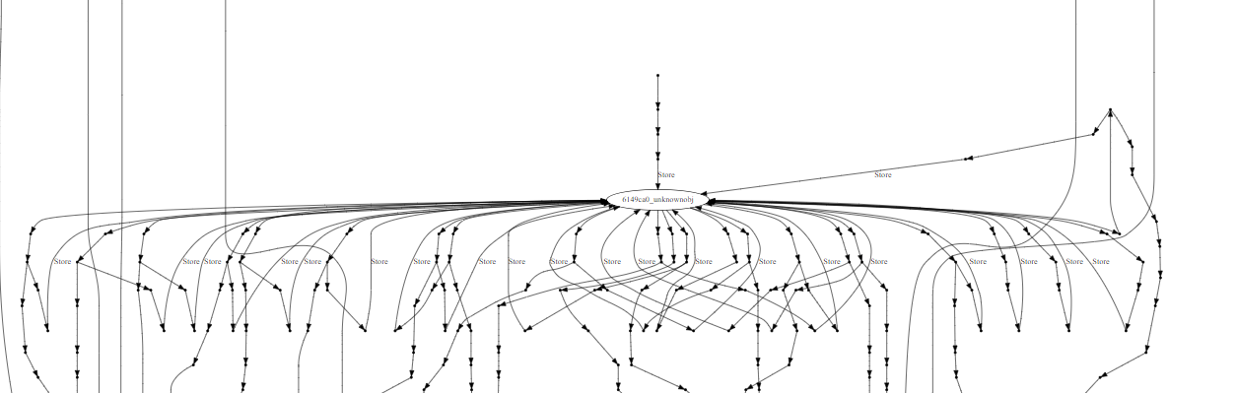
Reverse Tainting the Value
Parts of one tainted variable diagram

Slide 50
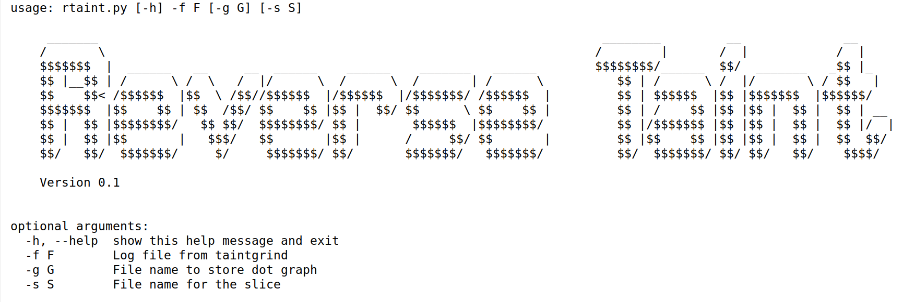
rtaint
https://github.com/Cycura/rtaint

Slide 51
rtaint
-f
This is the name of the log file created by Taintgrind. It can be in the compact version.
-g
The script can also produce the file in dot format used to generate a graph.
-s
This is the name of the file with the slice. Later, this can be used to display what operations where tainted with the values.

Slide 52
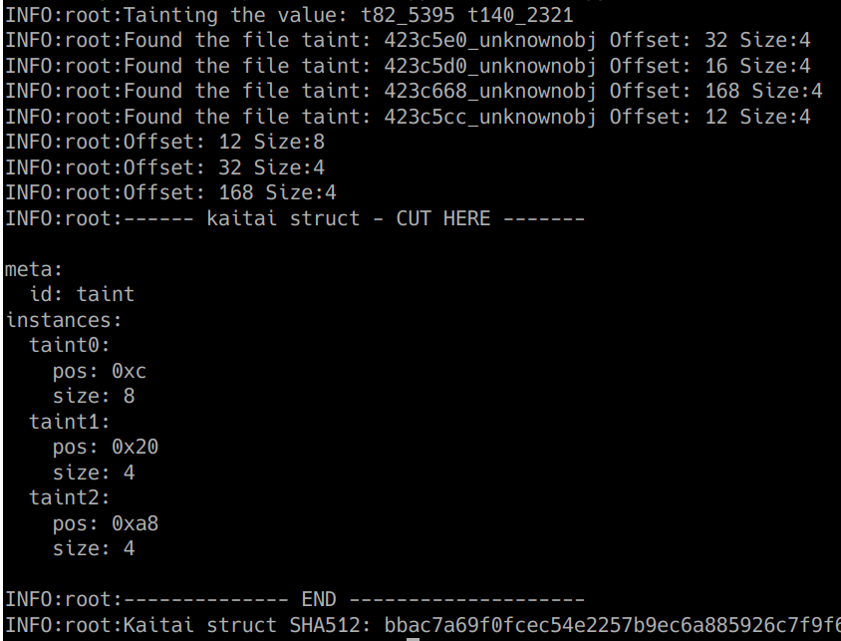
Reverse Tainting the Value
These are the values from the file inside causing the crash.

Slide 53
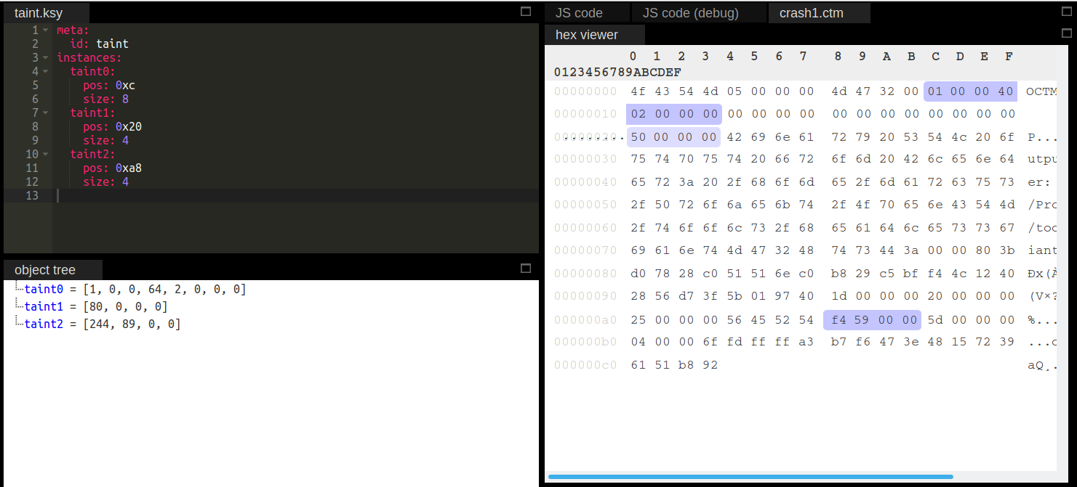
Crash File with Kaitai Struct

Slide 54
Reverse Tainting the Value
This is the SHA512 value calculated from the Kaitai struct. The value can be used to search for the duplicates.

Slide 55
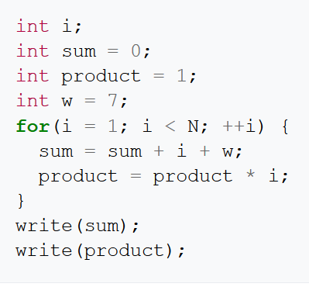
Slicing
It is the computation of the set of program statements, the program slice, that may affect the values at some point of interest, referred to as a slicing criterion.*
https://en.wikipedia.org/wiki/Program_slicing

Slide 56
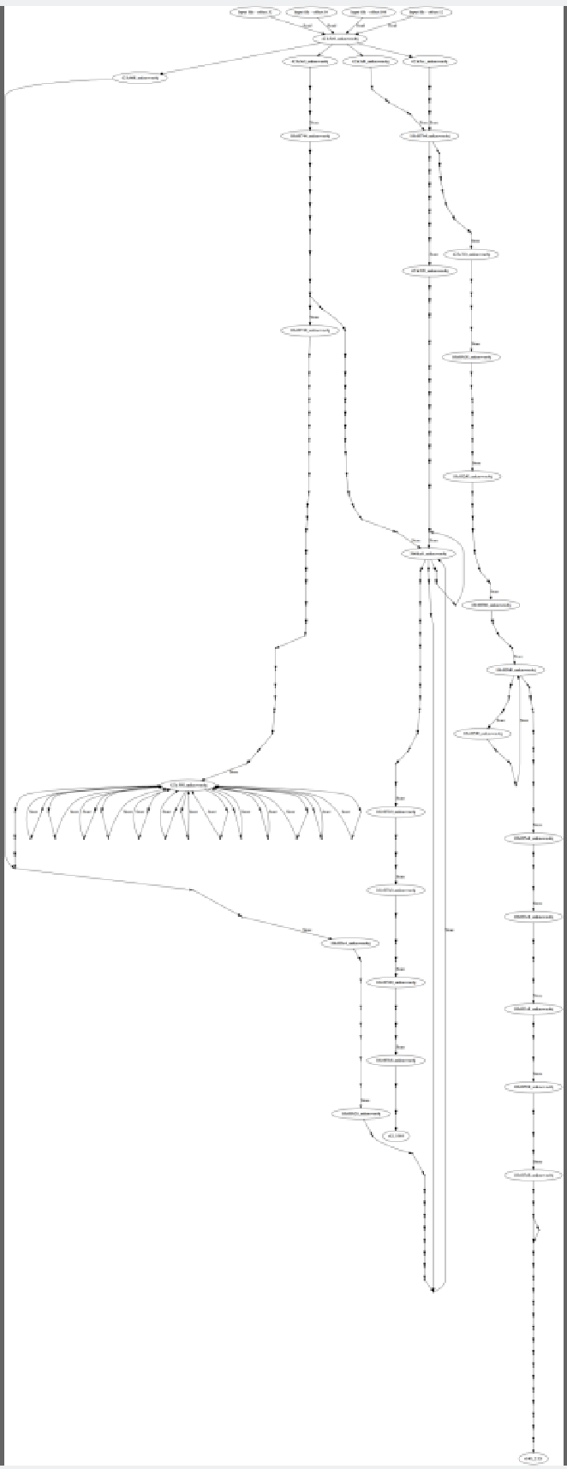
Graph
Taintgrind and rtaint allows to create a dot graph that can be converted with the graphviz package.

Slide 57
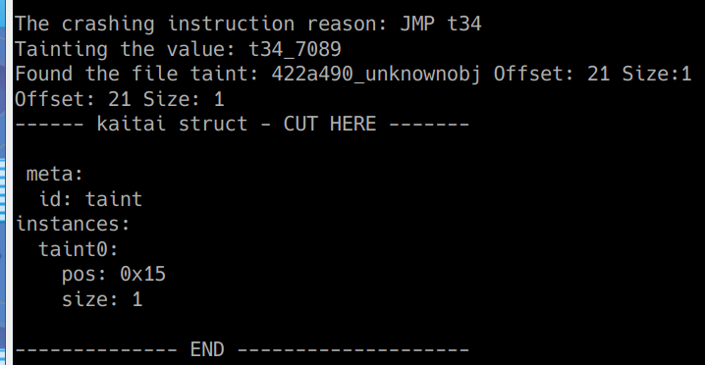
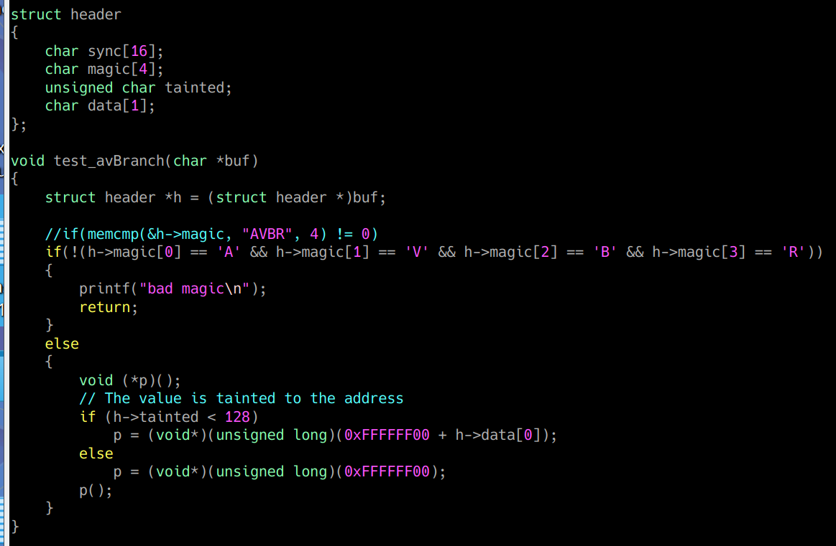
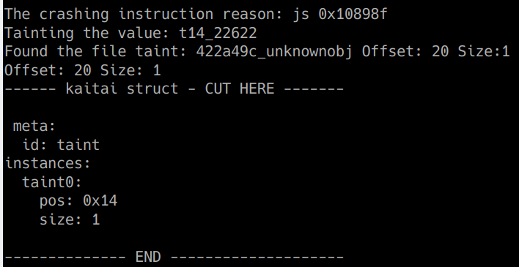
Demo

Slide 58
Crash Analysis with Reverse Taint
Powered by Taintgrind

Slide 59
Powered by ...
Free
Commercial
Moflow - https://github.com/Cisco-Talos/moflow/tree/master/BAP-0.7-moflow
Binary Ninja - https://blog.trailofbits.com/2019/08/29/reverse-taint-analysis-using-binary-ninja/
Triton - https://triton.quarkslab.com/
BARF - https://github.com/programa-stic/barf-project
libdft - http://www.cs.columbia.edu/~vpk/research/libdft/
TETRANE - https://www.tetrane.com/

Slide 60
What Next?
Updates
Address
Speed
The tainting starts from the last line inside the file. This is useful when there is a crash. But there is no way to taint any arbitrary instruction if the application doesn’t crash.
The way as it is written currently makes it slow. Optimization or the language change (thinking about Rust) is required.

Slide 61
What Next?
Issues
Currently the Taintgrind doesn't work on the ARM processors. This is caused by the Valgrind itself. It is missing some of the ARM conversions. The bug was already reported.

Slide 62
Summary
The solution is based on the Valgrind/Taintgrind. It means that supports all the system supported by Valgrind itself (+) But it also suffers from the Valgrind issues (-)
The process of creating taint log is time consuming (-) and the log is HUGE (-)
rtaint can be used in most of the cases making the analysis “faster” and automated. Easy to incorporate to other tools. (+)
The Python may not be the best solution for the rtaint. Too slow? (-)
It requires more testing on the real live application. I’m happy to receive any feedback :) (+)

Slide 63
References and Interesting Docs
https://github.com/wmkhoo/taintgrind
http://valgrind.org/
http://valgrind.org/docs/memcheck2005.pdf
https://users.ece.cmu.edu/~aavgerin/papers/Oakland10.pdf
https://www2.cs.arizona.edu/~debray/Publications/bit-level-taint.pdf
http://bitblaze.cs.berkeley.edu/papers/dta%2B%2B-ndss11.pdf
http://shell-storm.org/blog/Taint-analysis-and-pattern-matching-with-Pin/
https://www.blackhat.com/docs/eu-15/materials/eu-15-Kim-Triaging-Crashes-With-Backward-Taint-Analysis-For-ARM-Architecture.pdf

Slide 64
Special Thanks
Wei Ming Khoo

Slide 65
Questions

Slide 66

Thank you :)
mzmyslowski@cycura.com
@marekzmyslowski
https://github.com/Cycura/rtaint

